Slide 1

Asylum law for non-lawyers

Slide 2

Learn about the requirements for a successful asylum case
01
Learn how to complete an asylum application
02
Question whether our current practices affect our ability to listen to and process refugee narratives
03

Slide 3

Agencies that deal with immigration include:
Department of Homeland Security (DHS)
United States Citizenship and Immigration Services (USCIS)
Immigration and Customs Enforcement (ICE)
Customs and Border Protection (CBP)
Transportation Security Administration (TSA)
Notes:
https://www.dhs.gov/operational-and-support-components

Slide 4

Who qualifies for asylum?
A refugee
Who was persecuted or has a well-founded fear of future persecution
On account of a protected ground
Must have submitted her application within one year of arrival into the United States

Slide 5
Who is a Refugee?
The Act defines “refugee” as any person who is outside their country of nationality who is unable or unwilling to return to, and is unable or unwilling to avail herself of the protection of that country because of past persecution or a well-founded fear of persecution on account of race, religion, nationality, membership in a particular social group, or political opinion. INA § 101(a)(42)(A); 8 C.F.R. § 1208.13(b).

Slide 6
What does it mean to be persecuted?
  “Persecution” means a threat to the life or freedom of, or the infliction of suffering or harm upon, those who differ in a way regarded as offensive. Sangha v. INS, 103 F.3d 1482, 1487 (9th Cir. 1997).
  Persecution covers a range of acts and harms, and “[t]he determination that actions rise to the level of persecution is very fact-dependent.” Cordon-Garcia v. INS, 204 F.3d 985, 991 (9th Cir. 2000).

Slide 7
What does it mean to be persecuted (Cont)?
  Various forms of physical violence, including rape, torture, assault, and beatings, amount to persecution. See Chand v. INS, 222 F.3d 1066, 1073-74 (9th Cir. 2000) (“Physical harm has consistently been treated as persecution.”).
  However, persecution may also be emotional or psychological. See Duarte de Guinac v. INS, 179 F.3d 1156, 1163 (9th Cir. 1999) (referring to petitioner’s past persecution as including “physical and mental abuse”); see also Kovac v. INS, 407 F.2d 102, 105-07 (stating that persecution does not require physical harm, but rather any harm or suffering satisfies the persecution burden).

Slide 8
What are the protected grounds?
Race, Religion, Nationality, Political Opinion, or membership in a particular social group

Slide 9

What is a particular social group?
A group with members who “share a common, immutable characteristic” that “members of the group either cannot change, or should not be required to change because it is fundamental to their individual identities or consciences.” Matter of Acosta, 19 I. & N. Dec. 211, 233 (BIA 1985).

Slide 10
What is a particular social group (CONT)?
In 2014, Matter of M-E-V-G specified that the group must be:
(1) composed of members who share a common immutable characteristic, (2) defined with particularity, and (3) socially distinct within the society in question.

Slide 11
exceptions to the
one-year filing rule:
Changed circumstances which materially affect the applicant’s eligibility for asylum, or
Extraordinary circumstances relating to the delay

Slide 12
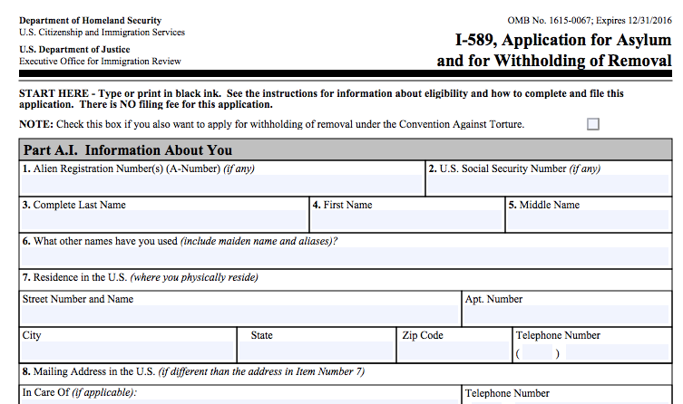
Page 1: biographical information

Slide 13
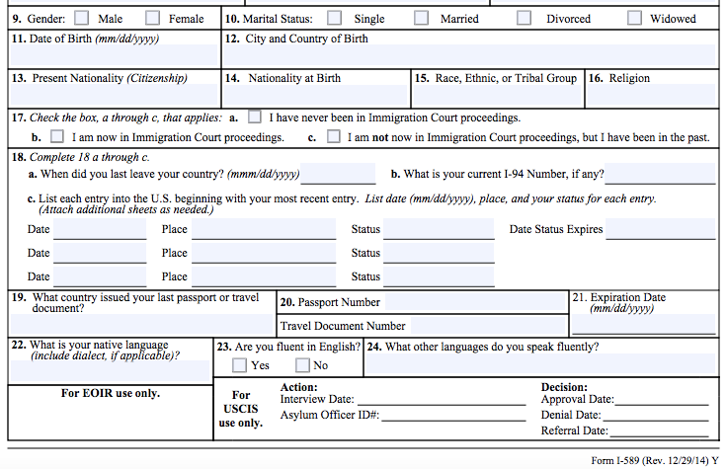
Page 1 (Continued): biographical information

Slide 14
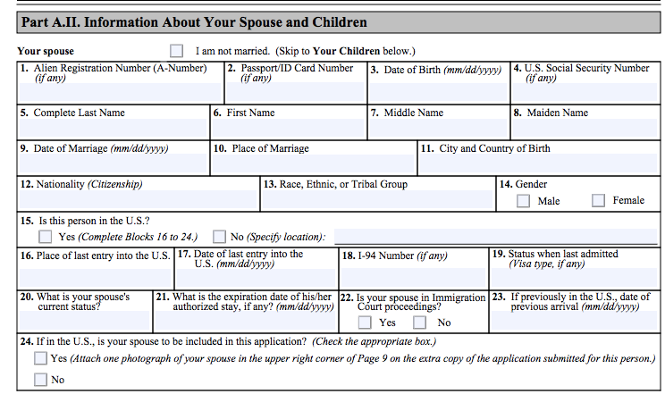
Page 2: Spouse & Children

Slide 15
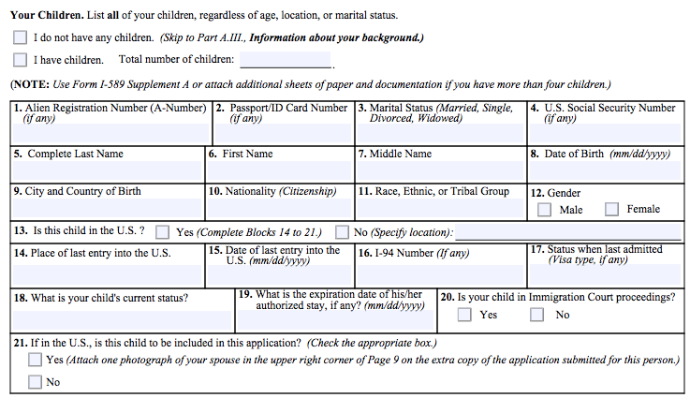
Page 2 (continued): Children

Slide 16
Page 3: Additional Children

Slide 17
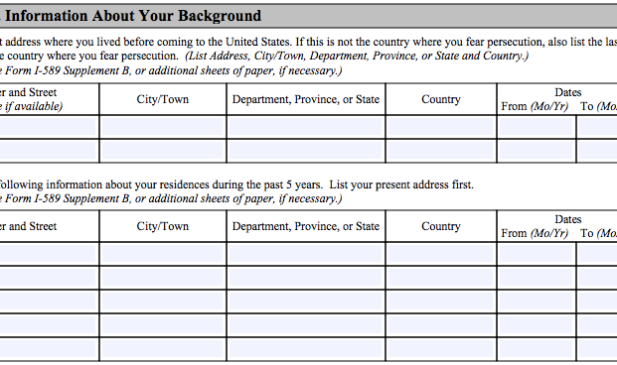
Page 4: five years of Residences

Slide 18
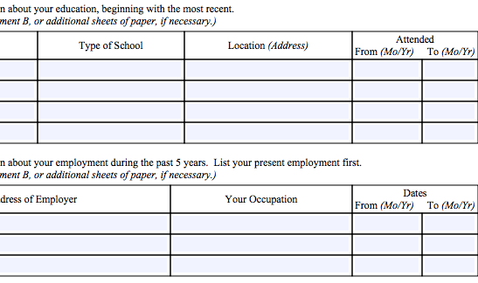
Page 4 (Continued): All Schools (ever)
and employers for the last five years

Slide 19
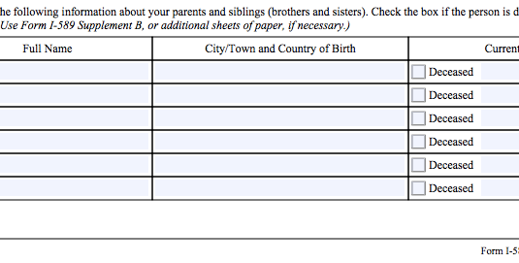
Page 4 (Continued): Names, Places of Birth and Current Locations of parents and siblings

Slide 20
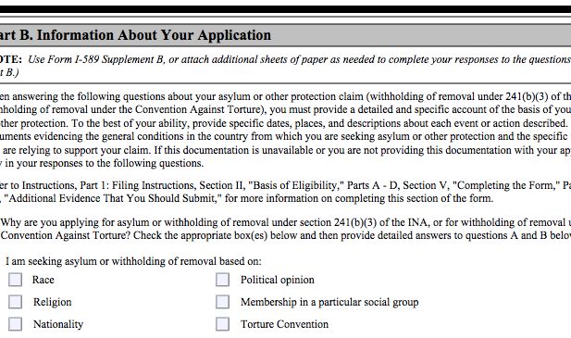
Page 5: Grounds for asylum

Slide 21
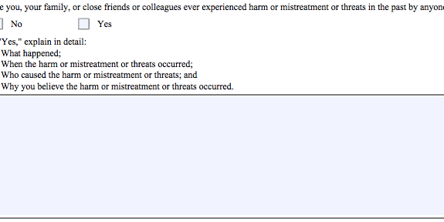
Page 5 (Continued): Explain (PAST) HARM TO YOU
OR YOUR FAMILY, CLOSE FRIENDS, OR COLLEAGUES

Slide 22
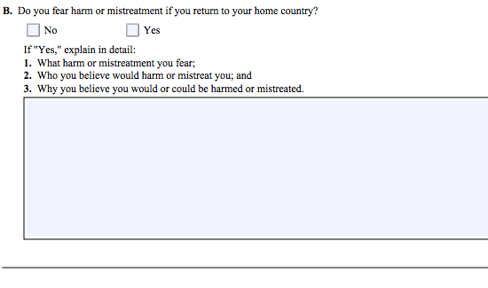
PAGE 5 (Continued): ARTICULATE FEAR OF RETURN

Slide 23
PAGE 6: EXPLAIN THE FOLLOWING (IF APPLICABLE):
Arrests, interrogations, detentions, etc outside the United States
Membership in any groups (including political, religious, press or media, labor union, student group, ethnic group…)
Continued involvement with these groups
Fear of torture if deported

Slide 24
Page 7: EXPLAIN THE FOLLOWING (IF APPLICABLE):
Prior applications for asylum or refugee status
Which countries were crossed during journey to the US and why they didn’t seek asylum there
Involvement in the persecution of others

Slide 25
Page 8: EXPLAIN THE FOLLOWING (IF APPLICABLE):
Prior returns to the country being fled (after fleeing)
Timeliness of application (is it within the one year deadline)
Arrests, charges or convictions in the United States

Slide 26
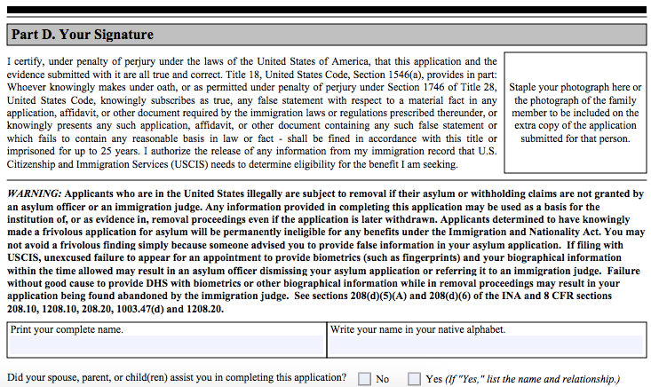
Page 9: Signature page w/photo stapled to corner

Slide 27
Questions?
Email us at info@adelanteknox.org.

